Slide 1
NYU TANDON CAREER HUB · FALL 2026
Data Science Bootcamp
Week 6 · Machine Learning Fundamentals, Perceptron
Instructor: Angelin Ann Jacob
Section 1 · Tues Nov 3
Notes:
Section-by-section slides for the Machine Learning Foundations notebook. Dataset: ai_salary_majors (TidyTuesday, October 2026), College Scorecard salaries joined with the AIOE AI exposure index.

Slide 2
Useful Links
Zoom
Brightspace
GitHub
All sessions are virtual. Use ONLY your NYU SSO Login to be considered for attendance
Assignments, submissions and the discussion board, monitored Monday to Thursday.
Slides and Colab notebooks for every session.
Email
1:1 coaching
datasciencebootcamp@nyu.edu for questions, extensions and attendance approvals.
Optional 30-minute technical interview prep. Book it through Handshake.

Slide 3






ML is the part of AI that learns rules from data
SECTION 1 · AI VS. ML VS. DEEP LEARNING
AI
TRADITIONAL PROGRAMMING
GPS route finding
+
Machine learning
data
rules
program
answers
spam filter
fraud alerts
MACHINE LEARNING
+
Deep learning
face unlock · chatbots
data
answers
learn
rules (a model)
Notes:
AI: any method for a task we think needs intelligence; rules can be hand-written (GPS route search). ML: learns the rules from examples (spam filters, fraud alerts, Zillow estimates). Deep learning: ML with many-layered neural networks built from perceptron-like units (face unlock, chatbots). Right side: traditional programming takes data + rules and gives answers; ML takes data + answers and gives back the rules.

Slide 4


Does the data come with answers?
SECTION 2 · TYPES OF MACHINE LEARNING
SUPERVISED
UNSUPERVISED
REINFORCEMENT
action
agent
reward +1
world
answers given: learn to predict them
no answers: find the groups
no answers: learn from rewards
COLAB SAMPLE DATA · FIND THE ANSWER COLUMN
California Housing
longitude
latitude
rooms
population
median_income
median_house_value
answer = a number
MNIST digits
label
px0
px1
px2
...
px783
answer = a category (0-9)
Notes:
Supervised: every example has an answer (label), so the model learns to predict it. Unsupervised: no answers, so the model finds groups. Reinforcement: an agent learns from rewards by trial and error. Both Colab sample datasets have an answer column, so both are supervised: house value is a number, the digit label is a category.

Slide 5
Every term, pointed at one table
SECTION 3 · KEY ML TERMINOLOGY
FEATURES X
LABEL y
SPLIT
field_of_study | starting salary | ai_exposure | salary 4 yr | set
Computer Science | $70,906 | 1.17 | $100,385 | train
Mechanical Engineering | $70,705 | 1.18 | $91,129 | test
Economics | $51,815 | 1.29 | $81,228 | train
Psychology, General | $31,680 | 1.26 | $50,152 | test
Dance | $21,878 | -1.16 | $39,716 | train
EXAMPLE
FEATURES X
MODEL
PREDICTION y_hat
TRUE LABEL y
$70,906
1.07 × x + 17,534
$93,395
$100,385
starting salary
parameters: slope, intercept
the model's answer
miss: $6,990
Notes:
One row is an example. Feature columns (X) go in; the label column (y) is what we predict. Rows are split into training and test data. The model is the learned rule; its parameters here are the slope and intercept of a line. The prediction y_hat is compared with the true y.

Slide 6






Seven steps, and the last one loops back
SECTION 4 · THE MACHINE LEARNING WORKFLOW
1 Define
2 Prepare
3 Explore
4 Split
5 Train
6 Evaluate
7 Improve
QUESTION 1 · REGRESSION
QUESTION 2 · CLASSIFICATION
$ → $
79 yes
198 no
starting salary → salary 4 years later
Who earns more: at least $80,000 after 4 years?
Notes:
Define, prepare, explore, split, train, evaluate, improve and repeat. Prepare: 8 majors had no four-year salary, our label, so they were dropped: 285 to 277. We ask one regression question (salary after four years, a number) and one classification question (at least $80,000, yes or no).

Slide 7
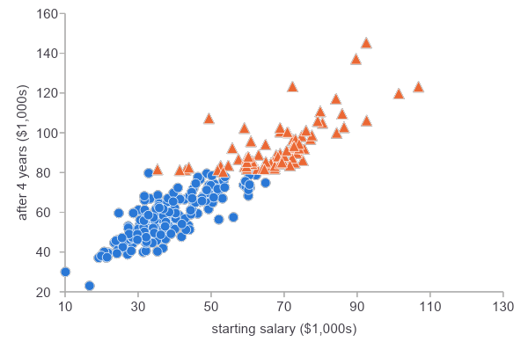
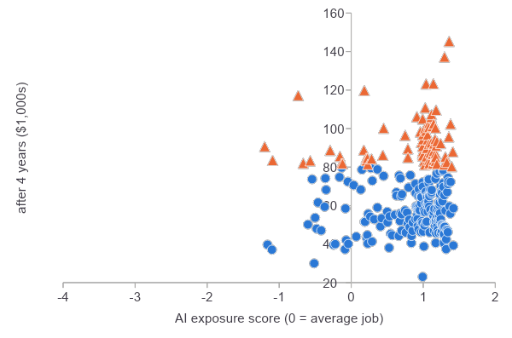
AI exposure does not set the paycheck
SECTION 4 · DATA STORY 1
STARTING SALARY vs. SALARY AFTER 4 YEARS
r = 0.92
AI EXPOSURE vs. SALARY AFTER 4 YEARS
r = 0.08
a strong feature
almost no signal
● high earner ● below $80k
Notes:
Before training, check which features relate to the label. Starting salary: r = 0.92. AI exposure: r = 0.08. The best-paid majors are often highly exposed to AI; only 9 of 79 high earners have below-average exposure. AI exposure measures overlap with what AI can do, not replacement.

Slide 8



Hide 20% of the majors until the very end
SECTION 5 · TRAIN-TEST SPLIT
TRAINING · 221 MAJORS
TEST · 56
Practice questions
training set: learn from these
Final exam, new questions
test set: checked once
No peeking
seeing the test early = leakage
28.5% high earners
28.6% high
test_size=0.2 random_state=42 stratify=high_earner
Notes:
Like a final exam with new questions: the model learns from the training set, and the test set tells us how it does on majors it has never seen (generalization). stratify keeps the share of high earners the same in both sets. Looking at the test set before the end is data leakage.

Slide 9
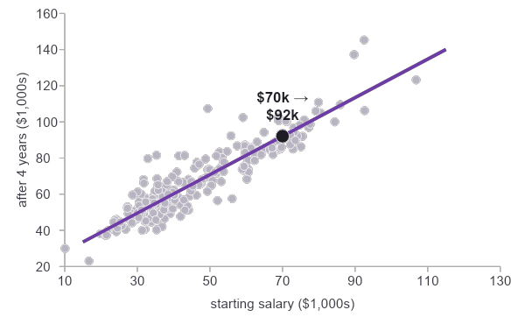
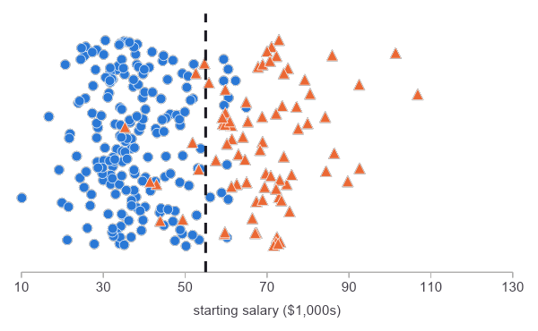
Post Training: Predict a number or a category
SECTION 6 · REGRESSION VS. CLASSIFICATION
REGRESSION · THE LABEL IS A NUMBER
CLASSIFICATION · THE LABEL IS A CATEGORY
Average miss $5,564 vs. always-guess-the-average $15,959
Rule start > $55k → high earner
Notes:
Regression: the label is a number. The learned line is salary_4yr = 1.07 x starting + 17,534; its average miss (MAE) on test majors is $5,564, versus $15,959 for the baseline that always guesses the average. Classification: the label is a category. Each dot is a major placed by starting salary; colour is the true answer; the dashed line is our hand rule at $55,000.

Slide 10
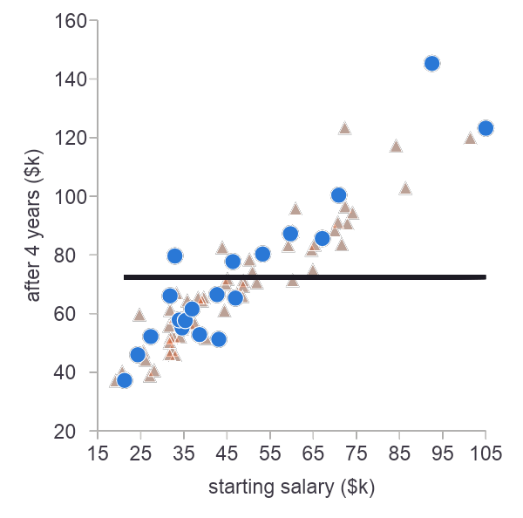
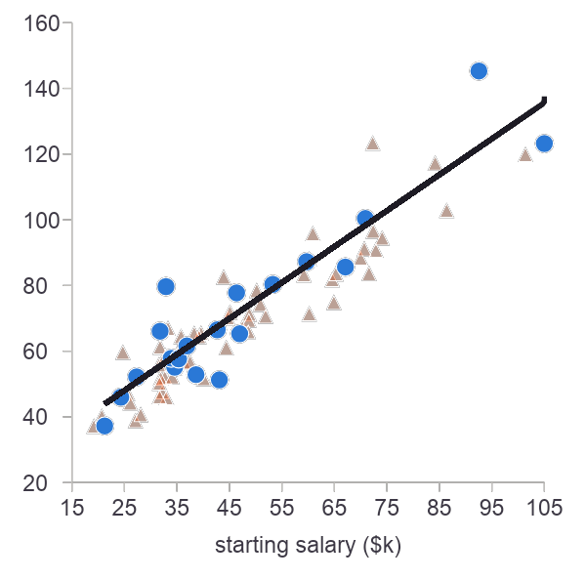
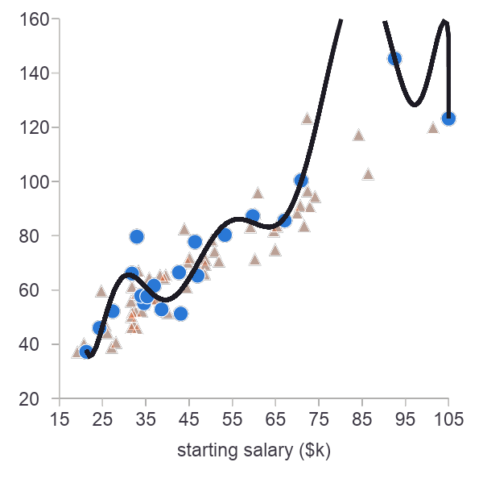
Too simple, just right, too wiggly
SECTION 7 · OVERFITTING AND UNDERFITTING
UNDERFIT · DEGREE 0
GOOD FIT · DEGREE 1
OVERFIT · DEGREE 10
20.0 train MAE
16.9 test MAE
7.0 train MAE
6.7 test MAE
4.3 train MAE
11.8 test MAE
Notes:
Curves of degree 0, 1 and 10 fitted to 20 training majors (blue). Orange triangles are test majors. Degree 0 misses the pattern; degree 1 captures it; degree 10 chases noise: lowest training error, but test error jumps to 11.8. With 150 training majors the degree 10 test error falls to 7.1. Note: the notebook cell currently defaults to SAMPLE_SIZE = 150 and DEGREES = [0, 1, 20]; these numbers use 20 majors and degrees [0, 1, 10], as in the answer key.

Slide 11
Sort every test major into four boxes
SECTION 8 · CONFUSION MATRIX, PRECISION, RECALL
RULE SAYS NO
RULE SAYS YES
PRECISION
of 17 it called yes, how many are right?
truly
no
15 / 17 = 0.88
RECALL
of 16 real yeses, how many found? (○ = missed)
38 true negatives
2 false alarms
truly
yes
15 / 16 = 0.94
ACCURACY
53 / 56 = 0.95
1 miss
15 true positives
Notes:
Hand rule: start > $55,000. Each dot is one of the 56 test majors; colour is the truth, the box is the prediction. TN 38, FP 2, FN 1, TP 15. Precision: of the 17 majors the rule called high earners, 15 really are (0.88). Recall: of the 16 real high earners, the rule found 15 (0.94). Accuracy: 53 of 56 (0.95).

Slide 12
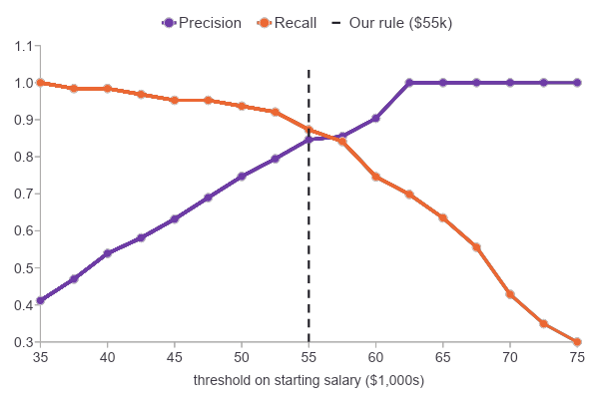
Accuracy can lie
SECTION 8 · DATA STORY 2
LAZY MODEL · ALWAYS SAYS NO
CHOOSING THE THRESHOLD (TRAINING SET)
71%
0%
accuracy: 40 right
recall: 0 of 16 found
Notes:
The laziest model always says No. It is right on all 40 non-high-earners and wrong on all 16 high earners: 71% accuracy, 0% recall. Only 29% of majors are high earners (class imbalance). Right: moving the threshold on the training set trades precision for recall; choose it on training data only.

Slide 13

Neuron vs Perceptron: that says yes or no
SECTION 9 · INTRODUCTION TO THE PERCEPTRON
NEURON
PERCEPTRON
x1
w1
Σ + b
1 / 0
x2
signals in
strong links
adds up
fires or not
w2
inputs
weights
weighted sum + bias
step → 1 or 0
Basic Neuron - Building block of nerve.
Basic Perceptron - Building block of neural net.
Notes:
Frank Rosenblatt, 1958. A neuron receives signals, adds them up, and fires only if the total is strong enough. The perceptron does the same with numbers: inputs times weights, plus a bias, then a yes/no decision. Stack many of them and you get deep learning.

Slide 14
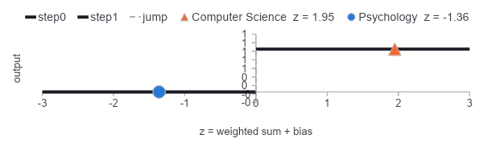
Run one major through the perceptron
SECTION 10 · INPUTS, WEIGHTS, BIAS, ACTIVATION
COMPUTER SCIENCE
b = -0.5
x1 = 1.41
starting salary
w1 = 1.5
1
high earner ✓
z
1.95
step(z)
1 if z > 0, else 0
x2 = 0.67
AI exposure
w2 = 0.5
1.5×1.41 + 0.5×0.67 − 0.5
ACTIVATION · THE STEP FUNCTION
SCALE FIRST · STANDARDIZE
starting salary
AI exposure
both, scaled
0 = average for every feature
Notes:
Computer Science, standardized: x1 = 1.41 (starting salary), x2 = 0.67 (AI exposure). With w1 = 1.5, w2 = 0.5, b = -0.5: z = 1.95, so the step function outputs 1. Correct: it pays $100,385 after four years. Psychology, General gives z = -1.36: output 0, also correct. Standardizing (0 = average) stops the salary, in tens of thousands of dollars, from drowning out AI exposure. The line where z = 0 is the decision boundary.

Slide 15
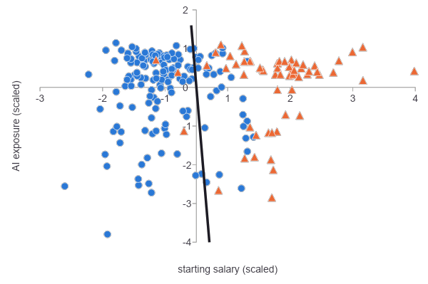
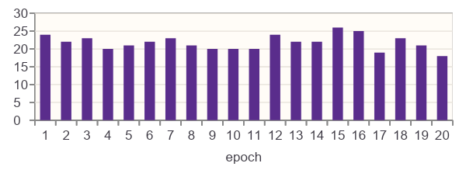
Move the line after every mistake
SECTION 11 · TRAINING A PERCEPTRON
LEARNED BOUNDARY · TRAINING MAJORS, SCALED
0
+1
−1
correct
miss
false alarm
nothing changes
line moves toward it
line moves away
MISTAKES PER EPOCH
never reaches 0: the classes overlap
Notes:
Rule: error = y - y_hat; w = w + lr * error * x; b = b + lr * error. A miss (+1) pulls the line toward the example; a false alarm (-1) pushes it away; a correct answer changes nothing. After 20 epochs at lr = 0.1 the salary weight is 0.214 and the AI exposure weight 0.011: the line is almost vertical, so the perceptron decides by salary, matching Data Story 1. The majors are not linearly separable, so mistakes never reach zero.

Slide 16
One straight line cannot solve XOR
SECTION 12 · LINEAR SEPARABILITY AND XOR
AND
OR
XOR
XOR, 2 LAYERS
?
1 line ✓
1 line ✓
1 line ✗
2 lines ✓
● output 1 ● output 0
Notes:
AND and OR are linearly separable, so the perceptron learns them perfectly. XOR (exactly one input is 1) puts the yeses on opposite corners: no single line works; the best is 3 of 4. Minsky and Papert, 1969, showed this and neural-network funding dropped for years. The fix: two layers. One layer draws two lines, the next combines them: a multi-layer perceptron, the start of deep learning.

Slide 17




Perceptron From Scratch Code vs Library
SECTION 13 · FROM SCRATCH AND WITH SCIKIT-LEARN
FROM SCRATCH
SCIKIT-LEARN
y_hat = 1 if w@x + b > 0 else 0
w += lr * (y - y_hat) * x
b += lr * (y - y_hat)
p = Perceptron(eta0=0.1, max_iter=20)
p.fit(X_train_s, y_train_c)
p.predict(X_test_s)
FROM SCRATCH · A LOOP AND ONE RULE
SCIKIT-LEARN · THREE CALLS
predict
error
update
create
learn
answer
step(w@x + b)
y - y_hat
w += lr*err*x
Perceptron()
.fit(X, y)
.predict(X)
repeat for every erroneous epoch
Notes:
From scratch: a loop and the update rule. scikit-learn: the same rule in three lines; it shuffles each epoch and stops early, so it lands on a different line. On non-separable data the perceptron keeps the last line it reached, not the best one. On the 56 test majors, the hand rule still wins.

Slide 18








Ten ideas from today
SUMMARY
ML
Supervised
X and y
Split
Learning rule
learns rules from data
data comes with answers
features in, label out
judge on unseen data
fix it when wrong
Regression
Classification
Perceptron
Overfitting
Evaluation
number vs. category
weights, bias, step
great train, poor test
accuracy can lie
predict a category
Notes:
From our data: starting salary predicts the four-year salary (r = 0.92); AI exposure barely does (r = 0.08). Limitation: each row is the median of a whole major, not one student. Exercise 4: write a model card for your best classifier.

